Slide 1

RETRO GAMES
Group No.- NS06
Mr. VATSAL SINGH (19104006)
Ms. SHUBHANGI TRIPATHI (19104067)
Mr. PUSHKAR TELAVANE (19104011)
Project Mentor:Prof.Nahid Shaikh
Student Mentor:Ms.Diya Luniya

Slide 2


ABSTRACT
The idea of this project is to build gaming (programs) which we used to play in our childhood. To offer user to make a choice from set of mentioned games(through SWITCH CASE).These games are developed on C language on Dev C++ tool. This project is to bring those joyful days and childhood memories back to us. Pro-social games can increase empathy, co-operation, helping and emotional awareness.

Slide 3
INTRODUCTION
Our Project named RETRO GAMES is based on C.
The user is given choices of the available games from which they can choose.
TIC TAC TOE- maximum of 2 players can play this game. Winner is the player who manages to get all 3 blocks of same sign in any of row or column.
Snake Game- Each time the snake eats a piece of food, its tail grows longer, making the game increasingly difficult. The user controls the direction of the snake's head.
ASCII SHOWDOWN- a simple shooting game made in C. flashes the screen whenever the bullets hit player.

Slide 4
Problem Definition
To create source code of the retro games which were a great part of our childhood and early gaming stages in which user is given choices to choose from the mentioned games. The users can play these games and will be able to store their individual scores.

Slide 5
OBJECTIVES
Objective of our program is to bring back retro games through coding in C.
Playing RETRO games fulfills a purpose in their lives. This could include gaming for: relaxation, opportunities to exert control, enjoyment, creativity, socialization, prevent boredom, challenge, and achievement. It could also be used as a coping method or stress management.
The program is constructed keeping in mind that it should be user friendly as well as easy for any programmer to read and evaluate.

Slide 6
PROPOSED ARCHITECTURE
SWITCH CASE
GAME CHOICES
CASE 1
CASE 3
CASE 2
TIC-TAC-TOE
ASCII SHOWDOWN
SNAKE GAME

Slide 7
SNAKE GAME
FUNCTIONS USED AND THEIR WORK
For start and end of game
Display food
Display final score
When all lives completed
Maintain player record
To display character slowly
For the movement of snake
Used for the movement of snake
To print instructions of game
To create food at random location
void record
void ExitGame
Void Border
void gotoxy
void Gotoxy
void down
void up
void left
void right
void Score
void Move
void Food
void load
Void Print

Slide 8
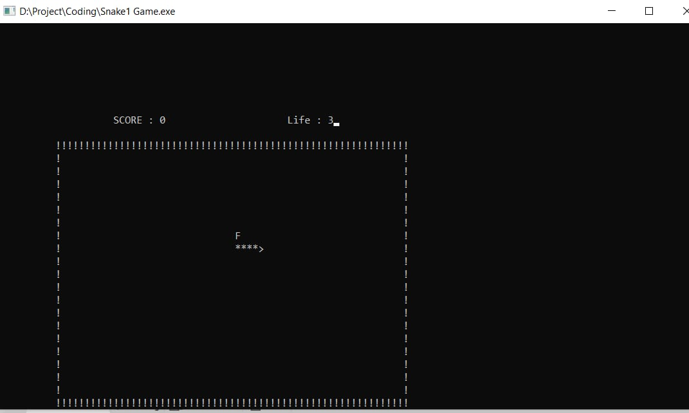
OUTPUT OF SNAKE GAME

Slide 9
TIC-TAC-TOE
MATRIX OF 3 BY 3
void board
int checkwin
int main
FUNCTION TO PRINT THE LAYOUT OF THE BOARD
FUNCTION TO DRAW BOARD OF TIC TAC TOE WITH PLAYERS MARK
FUNCTION TO RETURN GAME STATUS
1 FOR GAME IS OVER WITH RESULT
-1 FOR GAME IS IN PROGRESS
O GAME IS OVER AND NO RESULT

Slide 10
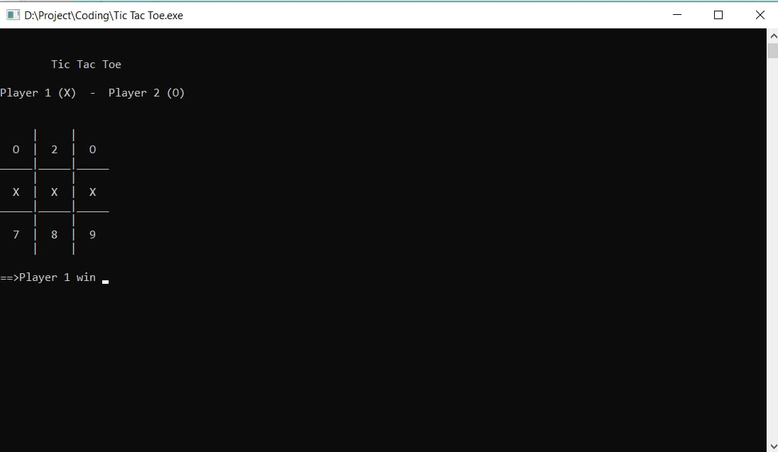
OUTPUT OF TIC-TAC-TOE

Slide 11
ASCII SHOWDOWN
GRID [20][41]
Movements included in arena
displays the title screen
border printing function
flashes the screen
prints winning message
prints scoreboard
prints the arena
prints score
void screenflash
void titlescreen
void win
void printbporder
int main
void printscoreboard
void printbuffer
void score

Slide 12
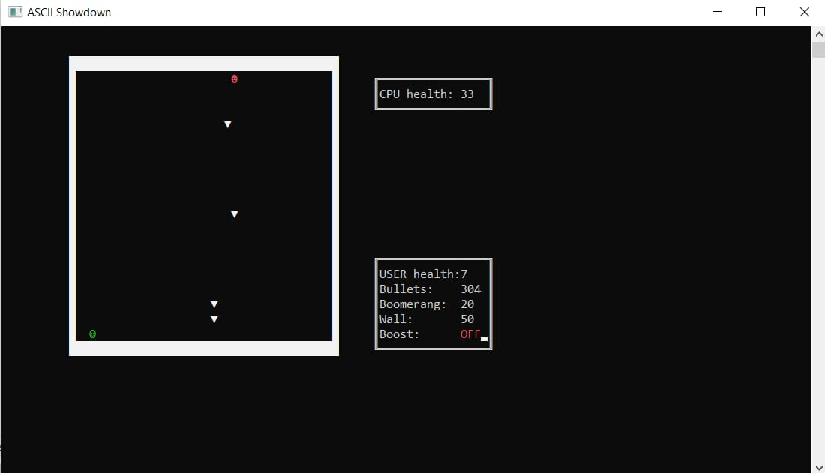
OUTPUT OF ASCII SHOWDOWN

Slide 13
CONCLUSIONS
When games are played in moderation and with mindfulness, they are a viable source of stress relief as well as a catalyst for mental health improvement and development of social skills. We are successfully able to run the codes of all games in C .

Slide 14
REFERENCES
https://www.quora.com/What-are-source-code-for-some-c++-basic-games-without-graphics.
https://www.codewithc.com/mini-project-in-c-snake-game/

Slide 15
THANK YOU

